Slide 1
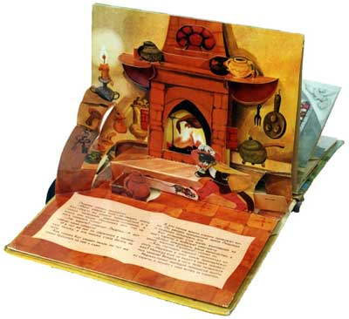
Objects & Event Handlers

Slide 2
Array
An array can be created in three ways.
The following code creates an Array object called myCars:
1: Regular:
var myCars=new Array(); myCars[0]="Saab"; myCars[1]="Volvo"; myCars[2]="BMW";
2: Condensed:
var myCars=new Array("Saab","Volvo","BMW");
3: Literal:
var myCars=["Saab","Volvo","BMW"];

Slide 3
Different Objects in One Array
All JavaScript variables are objects. Array elements are objects. Functions are objects.
Because of this, you can have variables of different types in the same Array.
You can have objects in an Array. You can have functions in an Array. You can have arrays in an Array:
myArray[0]=Date.now; myArray[1]=myFunction; myArray[2]=myCars;

Slide 4
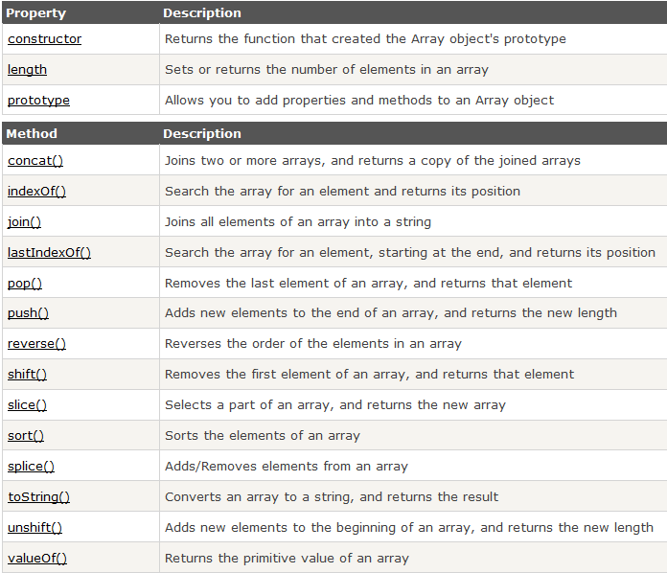
Array Properties and Methods

Slide 5
Everything is an Object
In JavaScript almost everything is an object. Even primitive datatypes (except null and undefined) can be treated as objects.
Booleans, Numbers, Strings can be objects or primitive data treated as objects.
Dates are always objects.
Maths and Regular Expressions are always objects.
Arrays are always objects.
Even functions are always objects.

Slide 6
Accessing Object Properties
Properties are the values associated with an object.
The syntax for accessing the property of an object is:
objectName.propertyName
This example uses the length property of the String object to find the length of a string:
var message="Hello World!"; var x=message.length;
The value of x, after execution of the code above will be 12

Slide 7
Accessing Objects Methods
Methods are the actions that can be performed on objects.
You can call a method with the following syntax:
objectName.methodName()
This example uses the toUpperCase() method of the String object, to convert a text to uppercase:
var message="Hello world!"; var x=message.toUpperCase();
The value of x, after execution of the code above will be
HELLO WORLD!

Slide 8
Creating a Direct Instance
The following example creates a new instance of an object, and adds four properties to it:
var person=new Object(); person.firstname="John"; person.lastname="Doe"; person.age=50; person.eyecolor="blue";
Alternative syntax (using object literals):
var person={firstname:"John",lastname:"Doe",age:50,eyecolor:"blue"};

Slide 9
Object Constructor
<!DOCTYPE html>
<html>
<body>
<script>
function person(firstname,lastname,age,eyecolor)
{
this.firstname=firstname;
this.lastname=lastname;
this.age=age;
this.eyecolor=eyecolor;
}
var myFriend=new person("John","Doe",50,"blue");
document.write(myFriend.firstname + " is " + myFriend.age + " years old.");
</script>
</body>
</html>
Once you have a object constructor, you can create new instances of the object, like this:

Slide 10
Adding Properties to Objects
You can add new properties to an existing object by simply giving it a value.
Assume that the person object already exists - you can then give it new properties:
person.nationality=“Swedish"; x=person.nationality;
The value of x, after execution of the code above will be:
Swedish

Slide 11
Arrays versus Objects
Arrays use numbered indexes.
Objects use named indexes.
Arrays are a special kind of objects, with numbered indexes.
When to Use Arrays? When to use Objects?
JavaScript does not support associative arrays (maps, dictionaries)
You should use objects when you want the element names to be strings (text).
You should use arrays when you want the element names to be numbers.

Slide 12
JavaScript for...in Loop
The block of code inside of the for...in loop will be executed once for each property:
<!DOCTYPE html>
<html>
<body>
<p>Click the button to loop through the properties of an object named "person".</p>
<button onclick="myFunction()">Try it</button>
<p id="demo"></p>
<script>
function myFunction()
{
var txt="";
var person={fname:"John",lname:"Doe",age:25};
for (var x in person)
{
txt=txt + person[x];
}
document.getElementById("demo").innerHTML=txt;
}
</script>
</body>
</html>

Slide 13
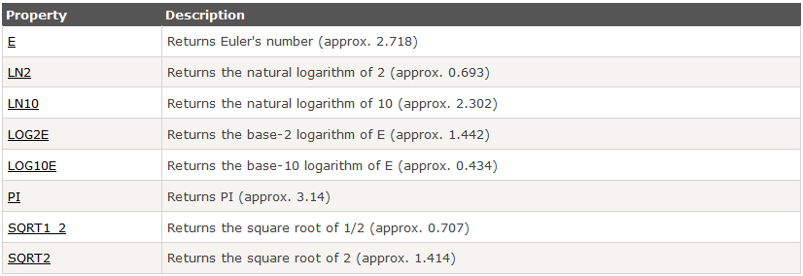
Math Object Properties
The Math object allows you to perform mathematical tasks.
All properties/methods of Math can be called by using Math as an object, without creating it.

Slide 14
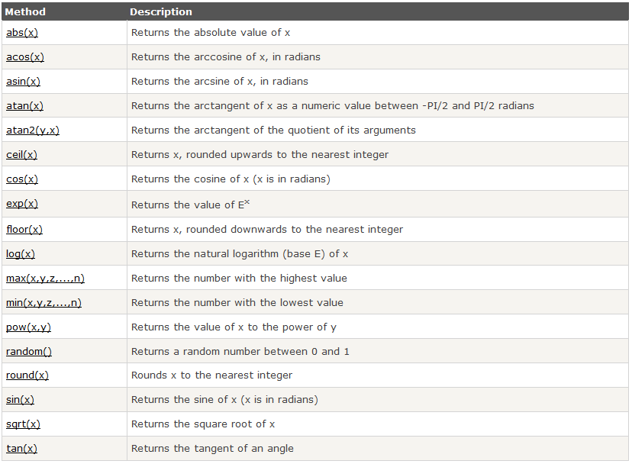
Math Object Methods

Slide 15
Event Handler
An event handler is a predefined JavaScript property of an object (in most cases an element in the document) that is used to handle an event on a Web page.
An event is something that happens when the viewer of the page performs some sort of action, such as clicking a mouse button, clicking a button on the page, changing the contents of a form element, or moving the mouse over a link on the page. Events can also occur simply by the page loading or other similar actions.
When events occur, you are able to use JavaScript event handlers to identify them and then perform a specific task or set of tasks. JavaScript enables you to react to an action by the viewer and to make scripts that are interactive, and more useful to you and to the viewer.

Slide 16
Event in HTML Element
To use an event handler, you add it as an additional attribute to an HTML tag. The only difference between an event handler “attribute” and an HTML attribute is that you can add JavaScript code inside an event handler attribute rather than just an attribute value:
<body>
<form>
<input type="button" value="Click Me!" onclick="window.alert('Hi!');" />
</form>
</body>
Notice that the alert command ends with a semicolon. This enables you to add additional JavaScript code after the alert, which enables you to perform multiple actions on the click event rather than just a single JavaScript statement.

Slide 17
Event in HTML Element
If the code you want to use becomes really long, you may wish to put the code in a function instead. The event handler can be used for any JavaScript code, so you can use it to call a function you have defined elsewhere.
function hi_and_bye() {
window.alert('Hi!');
window.alert('Bye!');
}
…
<body>
<form>
<input type="button" value="Click Me!" onclick="hi_and_bye();" />
</form>
<script type="text/javascript" src="js_event_01.js"></script>
</body>

Slide 18
Event Handler in the Script Code
You can also use an event handler within the script code. One way to do this is to give the element an id attribute and then use the JavaScript method document.getElementById() to access the element. Once that is done, you can tie an event to the element:
<body>
<form>
<input type="button" value="Click Me!" id="say_hi" />
</form>
<script>
function hi_and_bye() {
window.alert('Hi!');
window.alert('Bye!');
}
var hi_button = document.getElementById("say_hi");
hi_button.onclick = hi_and_bye;
// if you use hi_and_bye(); above, the function will be called straight away
</script>
</body>

Slide 19
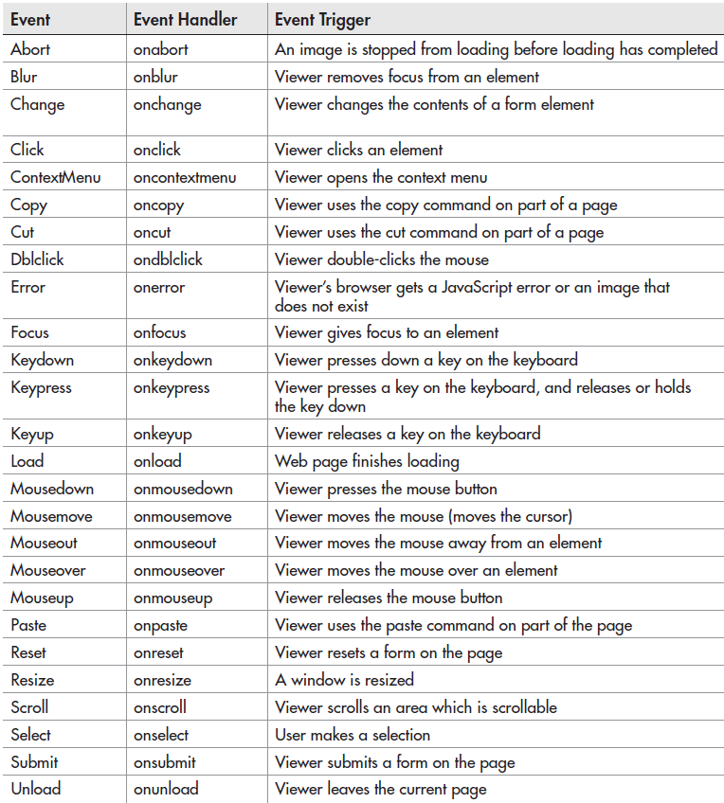

Slide 20
Example: onmouseover
<!DOCTYPE html>
<html>
<body>
<div onmouseover="mOver(this);" onmouseout="mOut(this);" style="background-color:#D94A38;width:120px;height:20px;padding:40px;">Mouse Over Me</div>
<script>
function mOver(obj)
{
obj.innerHTML="Thank You";
}
function mOut(obj)
{
obj.innerHTML="Mouse Over Me";
}
</script>
</body>
</html>

Slide 21
Example: onmousedown, onmouseup
<!DOCTYPE html>
<html>
<body>
<div onmousedown="mDown(this);" onmouseup="mUp(this);" style="background-color:#D94A38;width:90px;height:20px;padding:40px;">Click Me</div>
<script>
function mDown(obj)
{
obj.style.backgroundColor="#1ec5e5";
obj.innerHTML="Release Me“;
}
function mUp(obj)
{
obj.style.backgroundColor="#D94A38";
obj.innerHTML="Thank You“;
}
</script>
</body>
</html>

